Slide 1

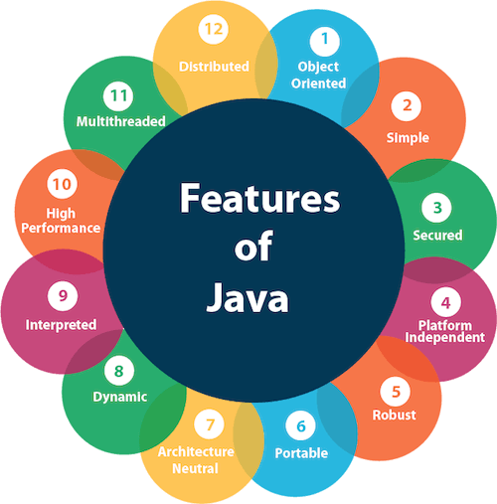
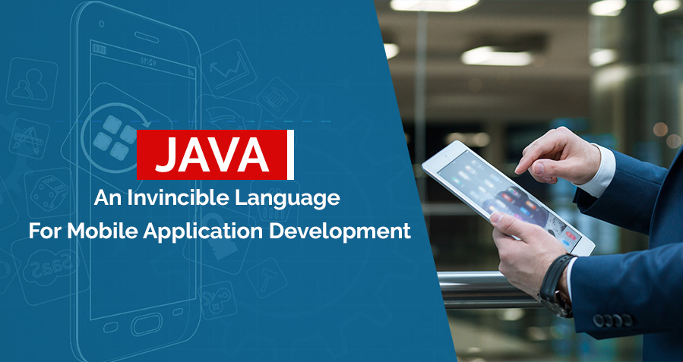
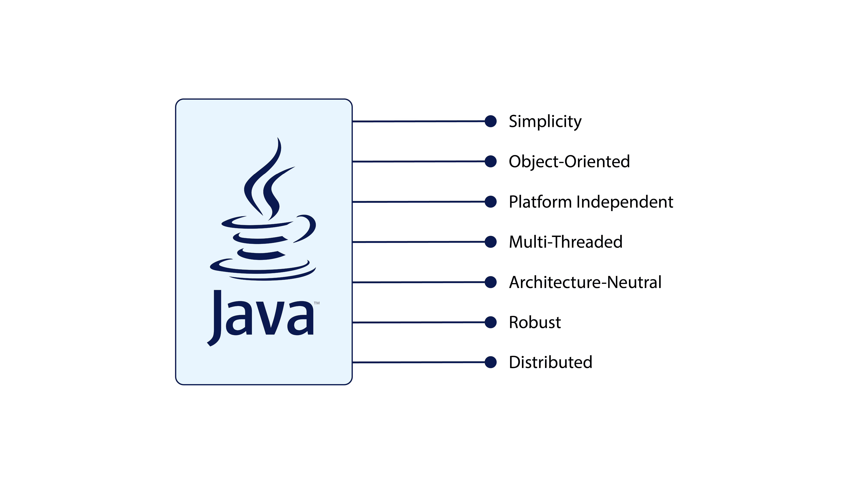
The Benefits and Real-World Applications of the Java Programming Language
Justyce Countryman | SUNY Jefferson Community College
What is Java?
What Makes Java Useful Today?
The Future of Java
Learning Java Is Valuable and Possible
A “programming language and computing platform” released in 1995 by Sun Microsystems
Functions many applications throughout the world wide web to ensure websites satisfies its visitors by three different approaches.
1: Servlets - Introduces an Application Programming Interface (API) that provides the bare necessities for programming web applications.
2: JavaServer Faces (JSF) - A more advanced API with not as much freewill for the programmer.
3: Frameworks - Code layouts are given to solve real world problems easily, like a “copy-and-paste” style.
Portability
Strong functionality on a variety of computing hardware
Virtual machine
Takes Java code from Android applications from one system and translates the code to work on another system.
Object-Orientation provides security and simplicity
Abstraction
We only care if the code works, not what is under the hood.
Encapsulation
Keeping code in a class private, meaning it is not available throughout the entire system
Inheritance
Allows for the creation of classes that make use of data from other classes.
Polymorphism
Code and variables may be used more than once to signify different scenarios.
Java is not expected to disappear anytime soon
Streaming applications
Websites and mobile software
Internet of Things
Every device in the world that connects to the internet to obtain and shares data
Artificial Intelligence
Computers that think and come up with solutions like us!
Big Data
A rivalry between “volume, velocity, and variety”
Predicts what the world will want
Real life problem-solving skills
Plenty of employment opportunities in mobile software
Employment may be significantly profitable
Designed to be beginner friendly
A community of programmers are available to help others
A great starting point before learning additional programming languages
Java is available on PCs, Macs, and Androids
Basic Coding Example
import java.util.Scanner; //Permits data from the
//keyboard or files
public class BeerCheck { //Java RUNS on classes
public static void main(String [ ] args) { //Main function
int age; //An integer called age
Scanner kbd = new Scanner(System.in);
//Allows for keyboard input
System.out.print(“Enter your age: “);
//Displays a prompt to the user
age = kbd.nextInt( ); //Gets an integer from the user
if(age >= 21) //Compares the value of age to 21
System.out.print(“You may have a beer!”);
else //The condition when the if statement is false
System.out.print(“You may have a root beer!”);
}
}
References
Information
https://www.java.com/en/download/help/whatis_java.html
https://blogs.oracle.com/oracleuniversity/post/why-does-java-remain-so-popular
https://www.makeuseof.com/tag/why-ios-less-ram-android/
https://stackify.com/oops-concepts-in-java/
https://litslink.com/blog/what-is-the-future-of-java
https://www.zdnet.com/article/what-is-the-internet-of-things-everything-you-need-to-know-about-the-iot-right-now/
https://www.ibm.com/cloud/learn/what-is-artificial-intelligence
https://builtin.com/big-data/big-data-examples-applications
https://www.cloudflare.com/learning/serverless/glossary/function-as-a-service-faas/
https://www.codingdojo.com/blog/should-i-learn-java
https://www.onlineschoolsreport.com/how-is-java-used-in-web-development/
Pictures
https://dev.java/assets/images/java-logo-vert-blk.png
https://cdn-clekk.nitrocdn.com/tkvYXMZryjYrSVhxKeFTeXElceKUYHeV/assets/static/optimized/rev-7b121b1/wp-content/uploads/2020/11/features-of-java_1.png
https://static.javatpoint.com/images/core/java-features.png
https://www.janbask.com/blog/wp-content/uploads/2018/06/Java-An-Invincible-Language-For-Mobile-Application-Development.jpg

